Slide 1
Digital Portfolio
STUDENT NAME: VALARMATHI.G
REGISTER NO AND NMID:2422K1854/
8416338A34FCE82983B483857BC347D
DEPARTMENT:BSC COMPUTER SCIENCE
COLLEGE: COLLEGE/ UNIVERSITY:AKSAYA COLLEGE OF ARTS AND SCIENCE BHARATHIAR UNIVERSITY

Slide 2
PROJECT TITLE
TEMPERATURE CONVERTER

Slide 3


AGENDA
Problem Statement
Project Overview
End Users
Tools and Technologies
Portfolio design and Layout
Features and Functionality
Results and Screenshots
Conclusion
Github Link
3/21/2024 Annual Review

Slide 4

PROBLEM STATEMENT
To design and implement a responsive and interactive Temperature Converter Web Application that allows users to convert temperature values between Celsius (°C), Fahrenheit (°F), and Kelvin (K) using HTML, CSS (with Tailwind CSS), and JavaScript.

Slide 5

PROJECT OVERVIEW
The Temperature Converter is a simple, interactive web application built using HTML, Tailwind CSS, and JavaScript. It is designed as a mini-project to demonstrate fundamental web development skills and provide a practical tool for users to convert temperatures across three commonly used units: Celsius (°C), Fahrenheit (°F), and Kelvin (K).

Slide 6

TOOLS AND TECHNIQUES
The development of the Temperature Converter Web Application involved a combination of front-end web technologies and modern design tools. These tools and techniques were selected to create a responsive, user-friendly, and functional web application with minimal complexity.

Slide 7

WHO ARE THE END USERS?
The Temperature Converter Web Application is designed for a broad range of users who require quick and accurate temperature conversions. It serves both educational and practical purposes, making it useful in various scenarios.

Slide 8
TEMPERATURE CONVERTER DESIGN AND LAYOUT
The Temperature Converter is a standalone web-based tool designed to allow users to convert temperature values between Celsius (°C), Fahrenheit (°F), and Kelvin (K). It is integrated as the final project section in the personal portfolio website of A. Keerthika, showcasing practical front-end development skills using HTML, Tailwind CSS, and JavaScript.

Slide 9
FEATURES AND FUNCTIONALITY
The Temperature Converter Web Application, created as part of the portfolio of A. Keerthika, demonstrates fundamental web development skills. The application provides a simple, responsive interface for users to convert temperature values between Celsius, Fahrenheit, and Kelvin.

Slide 10
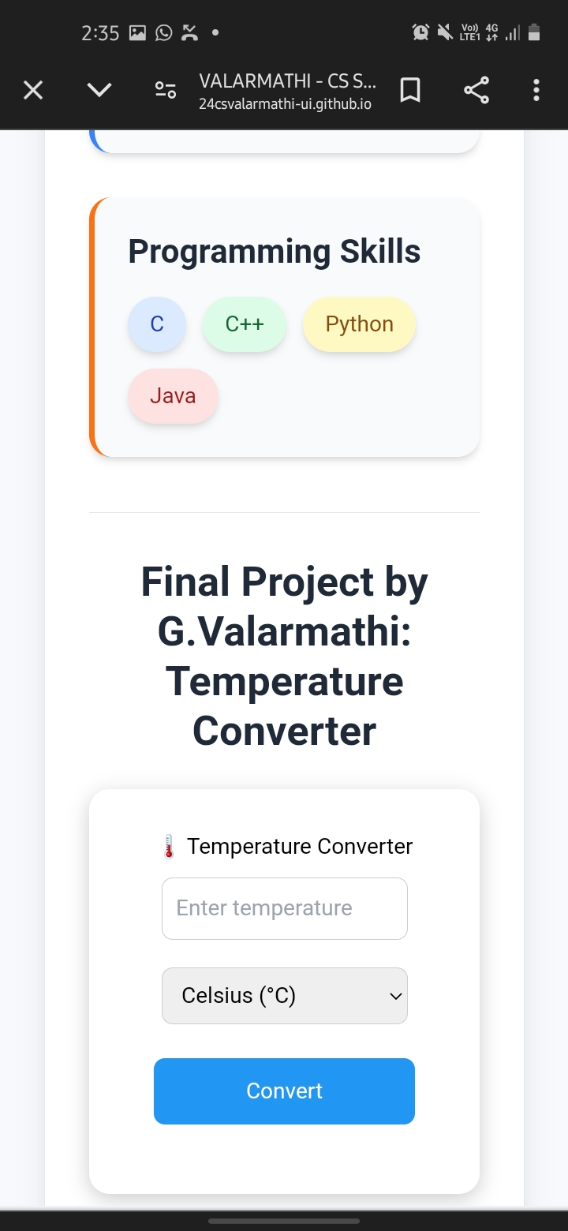


RESULTS AND SCREENSHOTS
3/21/2024 Annual Review

Slide 11
CONCLUSION
The Temperature Converter Web Application is a simple yet effective tool that demonstrates the practical application of core web development technologies — HTML, CSS (Tailwind CSS), and JavaScript. This project allowed the implementation of user input handling, real-time data processing, and responsive UI design.

